Slide 1
PERIPHERY AND SEMI-PERIPHERY IN THE WORLD ECONOMY
Lecture 15: COLONIALISM AND THE WORLD ECONOMY
Lecture 16: FROM PLANTATIONS TO AGRIBUSINESS

Slide 2
INTRODUCTION
What has been happening to the world beyond the so-called core? The next four lectures are devoted to this topic. The first two address the broad background before moving to discuss in detail the role of some countries and localities within them in the current globalization of production with respect to both manufacturing industries and the service sector.
A. Colonialism and the modern world economy
Themes:
1.Brief overview of impacts of European colonialism
2. Economic realignment and geographical polarization 1750-1970
3. Importance of the periphery in the world economy 1700s-1940
4. Slow decline of the periphery’s role in the word economy
a. Declining commodity terms-of-trade b. Declining barter terms-of-trade and c. resource curse

Slide 3
A. Colonialism and the Modern World Economy
3 zones
Shift in global center of economic gravity
Trade routes
Slavery and the plantation economy
Correlation with long-waves
1940s on – declining terms of trade for colonial/peripheral commodities
Resource curse

Slide 4
Economic realignment and geographical polarization 1750-1970
1. Three zones emergent between 15th and 19th centuries (core, periphery and semi-periphery) (Figure 1)
2. Decline of manufacturing in colonized/dominated countries (Figure 2).
3. Investment in plantation agriculture and extraction of industrial raw materials (Figures 3-5).
4. Correlation between “bursts” of colonialism and Kondratieff downturns e.g. 1880s (Figure 6).

Slide 5
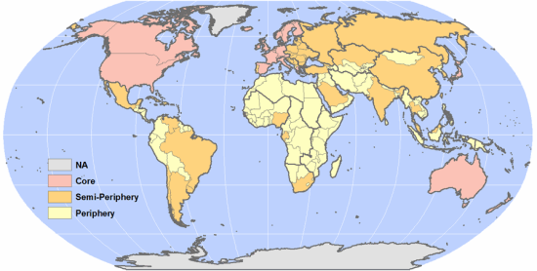
Figure 1

Slide 6
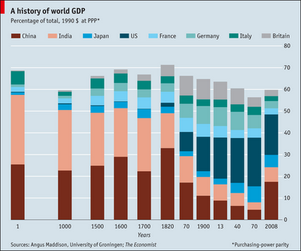
Figure 2

Slide 7
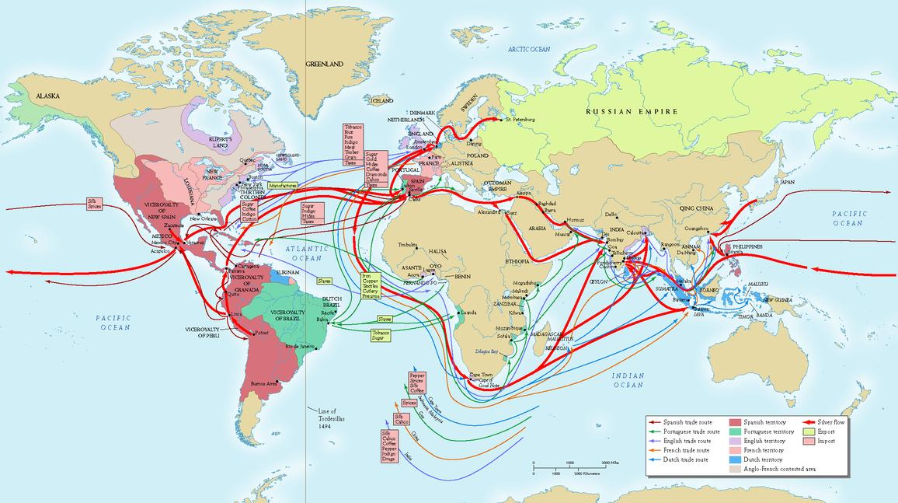
Figure 3: Colonial commodity trade routes 1700-1940

Slide 8
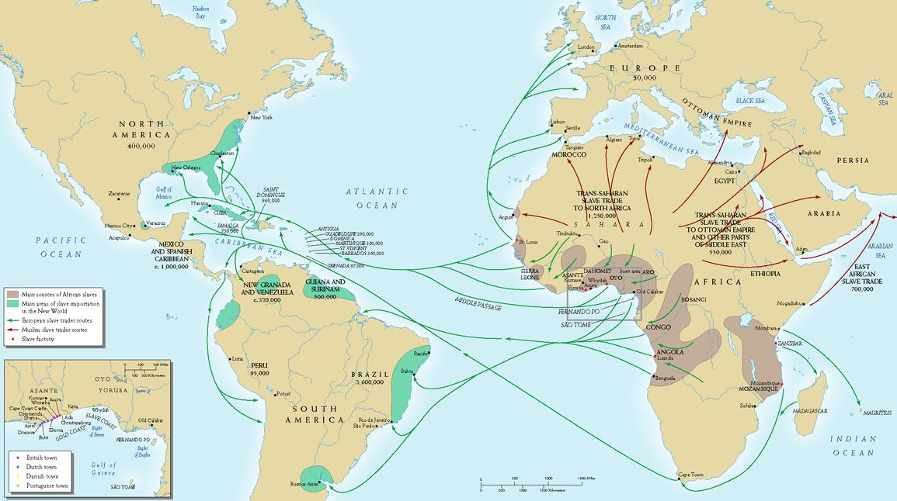
Figure 4: The slave trade in the late 1700s

Slide 9
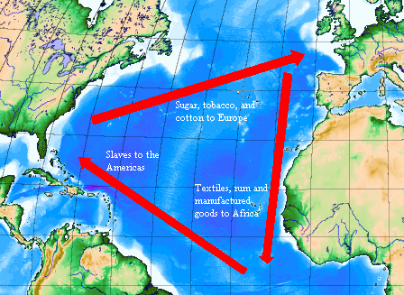
Figure 5: The colonial triangular trading system in the Atlantic world, late 1700s- 1860

Slide 10
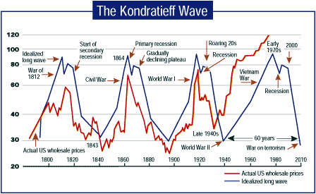
Figure 6: The Kondratieff Long-Wave Cycle

Slide 11
Periphery Important in Overall World Economy From 1700s until 1940s
Three-sided trading system: raw materials from periphery exported to Europe and the USA; manufactured goods exported from Europe and USA to Britain; manufactured goods exported from Britain to periphery (Figure 5).
Large countries with political independence (e.g. Mexico, Brazil, Argentina in 1920s/1930s) pursued import-substitution policies: semi-periphery.

Slide 12
Political independence for most of colonial world 1940s-1970 (Latin America after 1820s)
Declining commodity and barter terms-of-trade over time for basic commodity exports except for brief periods (early 1950s, 1970s) (Figures 7&8)
“Resource curse” hypothesis. Too much of one good thing? Examples of Argentina (agricultural commodities) and Equatorial Guinea (oil): easy money (corruption); why diversify? Raises exchange-rate (prices are not in local currencies) and makes imports more expensive. Thus across sub-Saharan Africa, resource intensive countries have decelerating growth relative to those less dependent on export of basic raw materials (Figure 9).

Slide 13
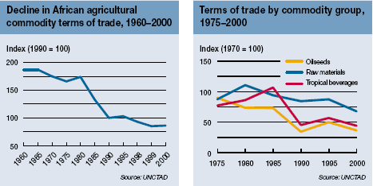
Figure 7:Commodity Terms of Trade

Slide 14
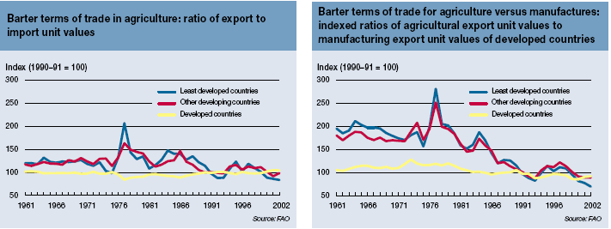
Figure 8: Barter Terms of Trade (prices of basic commodities versus manufactures)

Slide 15
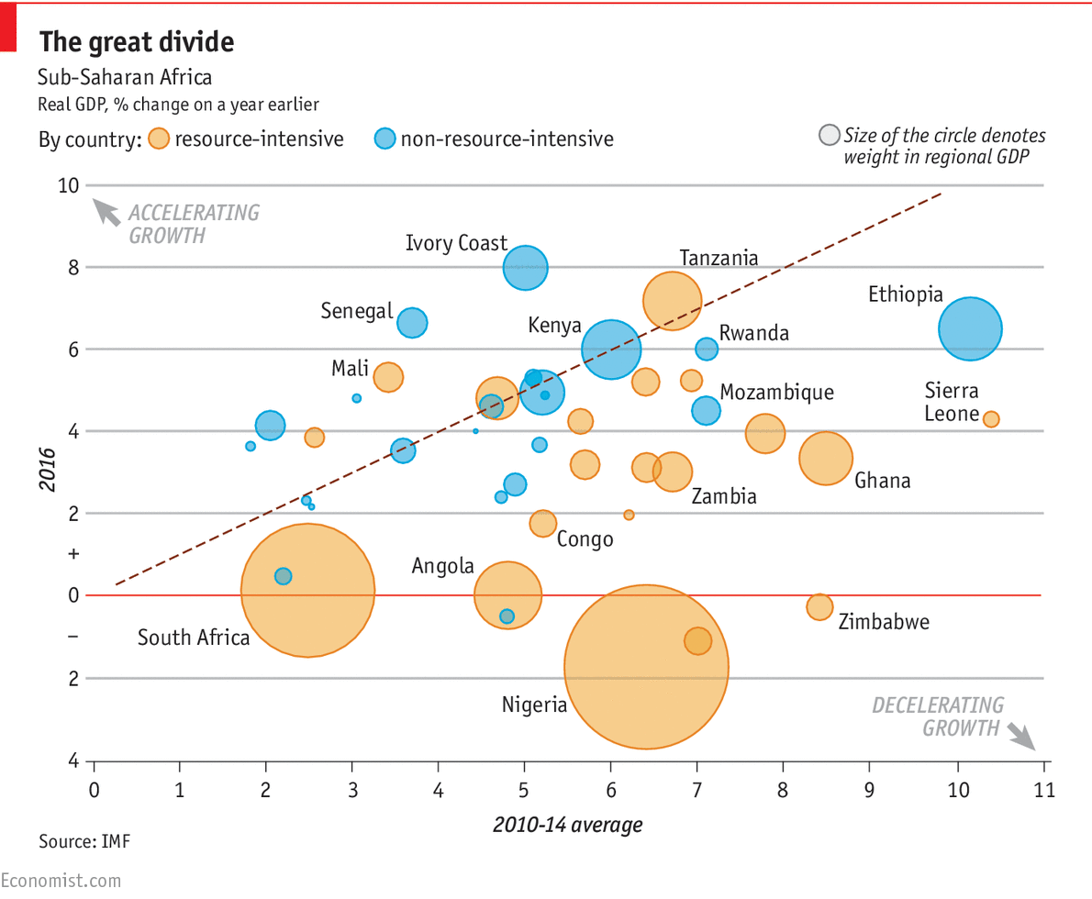
Figure 9: Resource Curse?

Slide 16
B. From Plantations to Agribusiness
What has tended to happen then since 1970 with the spread of globalization? Three stories:
1. Capitalization of export agriculture/resource extraction
2. Shift from import-substitution to local export-oriented manufacturing
3. Growth of global supply-chain manufacturing

Slide 17
(Deal with 2 and 3 in next lecture)
Capital-intensive agriculture particularly important in Latin America; in Africa cash-crop production peaked in 1950s (Figure 1 on cereal production) largely because of a lack of investment in improving soil fertility; in Asia food production (above all rice) not so much cash-crop agriculture except palm oil in Indonesia
Latin America and agricultural trade. It is Latin America that is most connected into global markets (Figure 2). It has had the the highest growth in “food surpluses” compared to other world regions outside the global core (Figure 3). But it is Africa in which foreign countries (particularly China and S. Korea) have begun to buy up land for future use largely for food production (Figure 4) But as yet this tend has not produced much change in agricultural output in Africa.

Slide 18
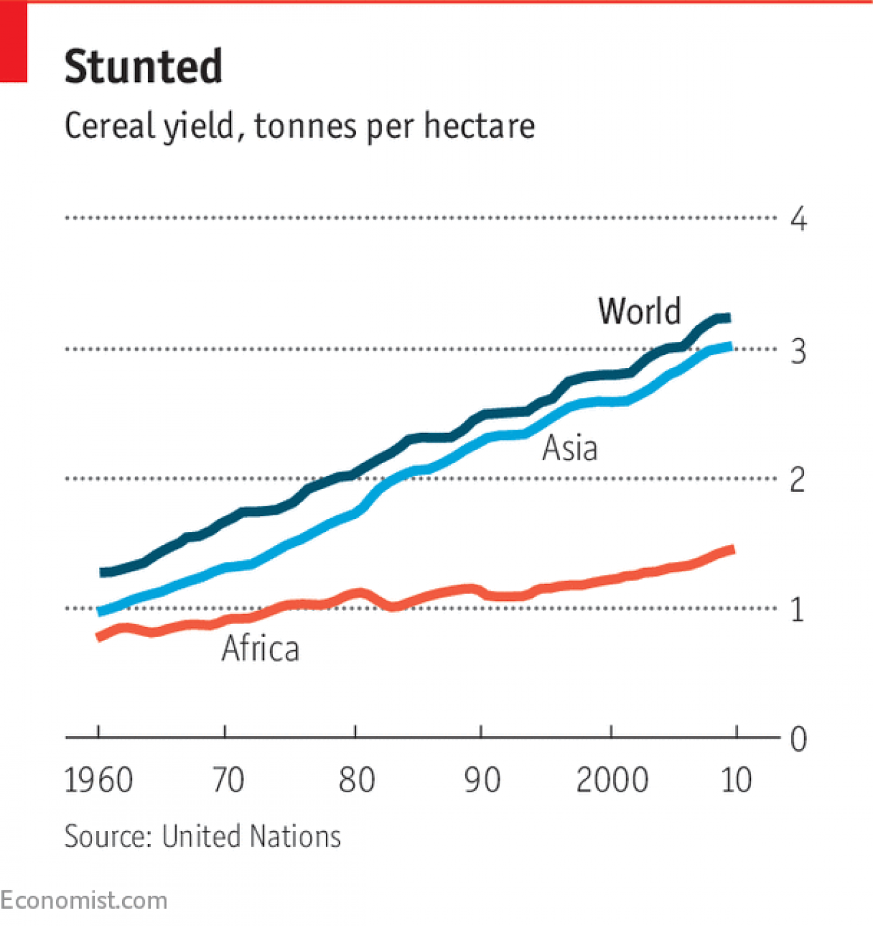
Figure 1: Cereal Yields in Africa

Slide 19
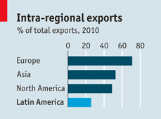
Figure 2: Which region is the least “regionalized”?

Slide 20
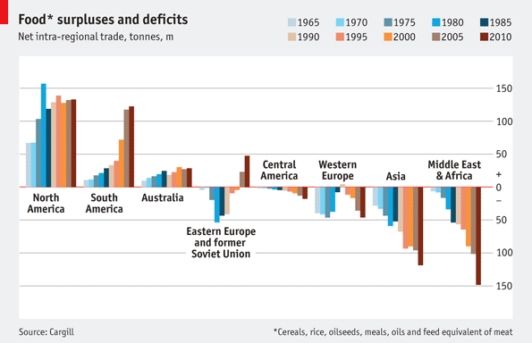
Figure 3: Whose ‘surplus” has risen the most and fastest?

Slide 21
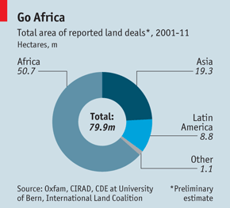
Figure 4: Land Grabs

Slide 22
CONCLUSIONS
Colonialism and the case against comparative advantage
Historic decline of manufacturing outside the global core
Decline in overall importance of periphery’s basic commodities in world economy since the 1940s (except oil)
Collapse of three-sided trading system leading up to the 1940s

Slide 23
Today, only in Latin America do the barter terms-of-trade of manufactured imports versus agricultural exports support basic commodity production as best economic growth strategy. Elsewhere manufacturing seems the better option … if you can pull it off.
That’s the topic for next time.

